Slide 1
CSCI 631 Foundations of Computer Vision
Ifeoma Nwogu
ion@cs.rit.edu

Slide 2
Schedule
Last class
Textures
Today
Segmentation especially k-means
Readings for today (Optional):
Forsyth and Ponce chapter 9

Slide 3
Digital image manipulations
Image processing
image in → image out
Image analysis
image in → measurements out
Image understanding
image in → high-level description out

Slide 4
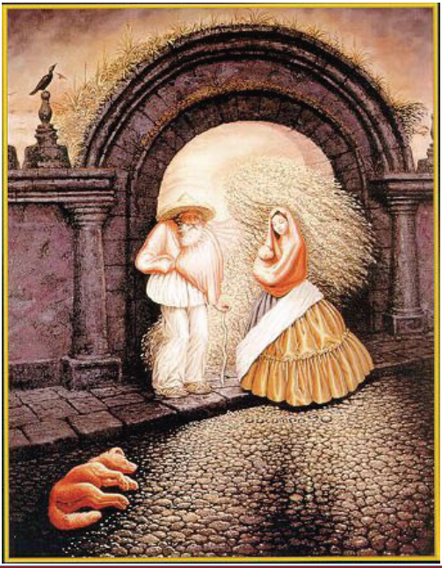
Perceptual grouping

Slide 5
Motion and perceptual organization
Humans interpret information “collectively” or in groups

Slide 6
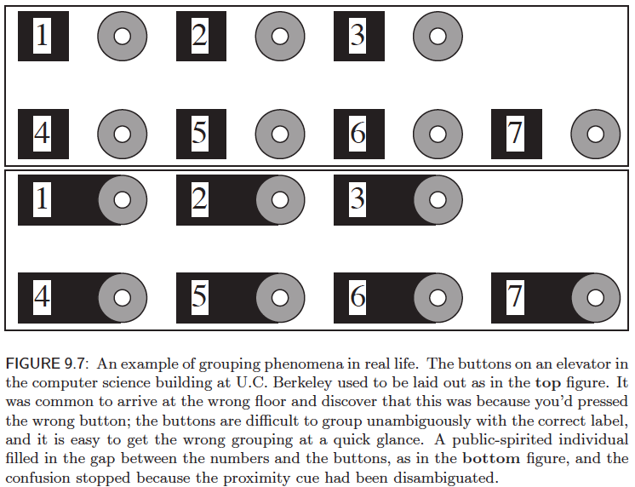
Slides accompanying Forsyth and Ponce “Computer Vision - A Modern Approach” 2e by D.A. Forsyth

Slide 7
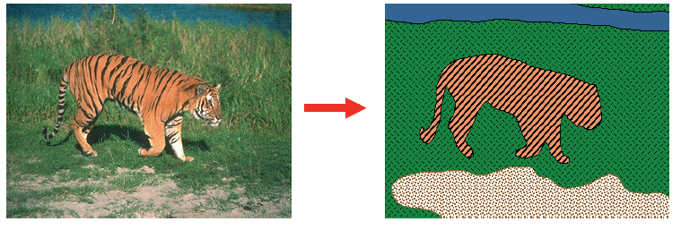
Image segmentation
The main goal is to identify groups of pixels/regions that “go together perceptually”

Slide 8
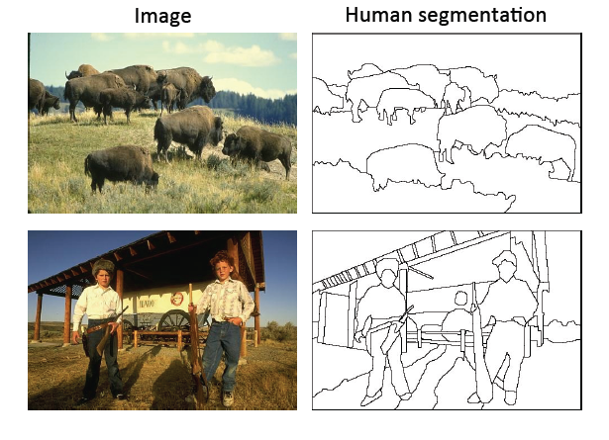
Image segmentation
Separate image into “coherent objects”

Slide 9
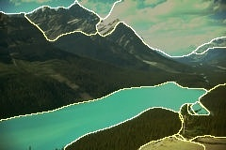
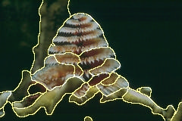
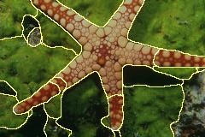
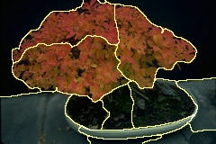
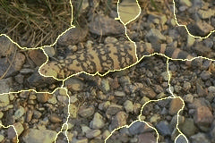
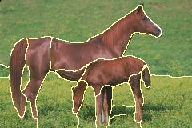
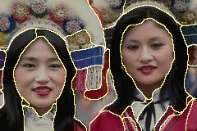
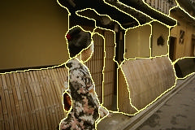
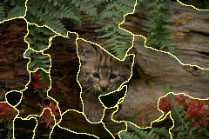
Examples of segmented images

Slide 10
Why do segmentation?
To obtain primitives for other tasks
For perceptual organization, recognition
For graphics, image manipulation

Slide 11
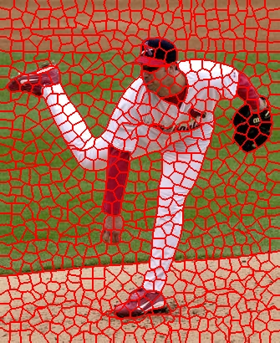
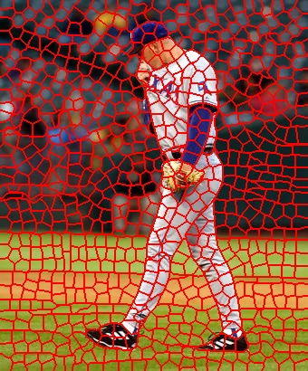
Task 1: Primitives for other tasks
Group together similar-looking pixels for efficiency of further processing
“Bottom-up” process
Unsupervised
“superpixels”
X. Ren and J. Malik. Learning a classification model for segmentation. ICCV 2003.

Slide 12
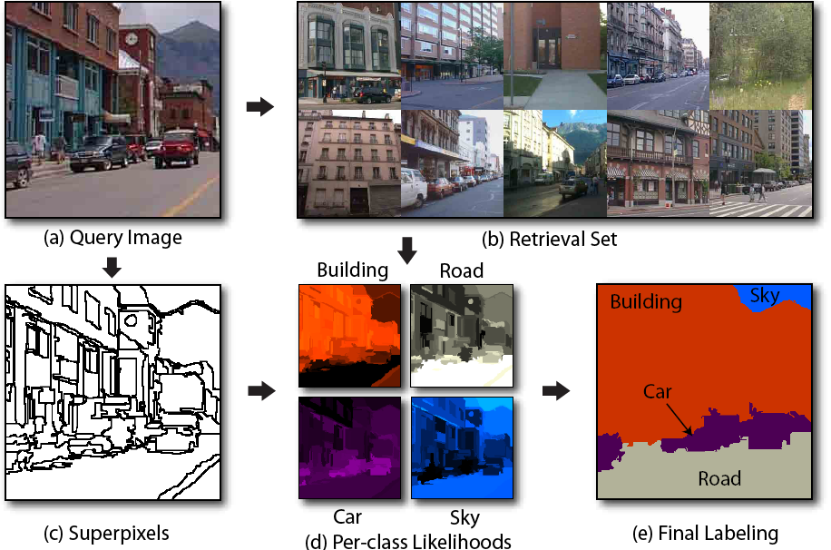
Example of segments as primitives for recognition
Image parsing or semantic segmentation:
J. Tighe and S. Lazebnik, ECCV 2010, IJCV 2013

Slide 13
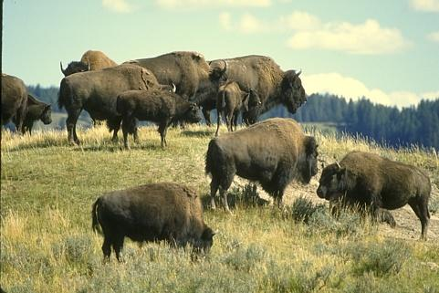
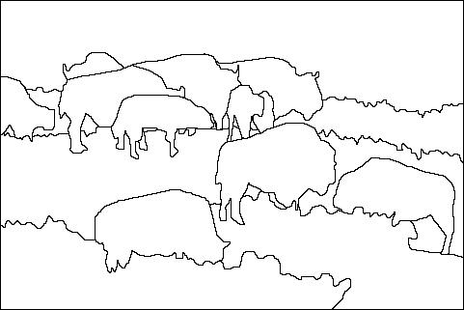
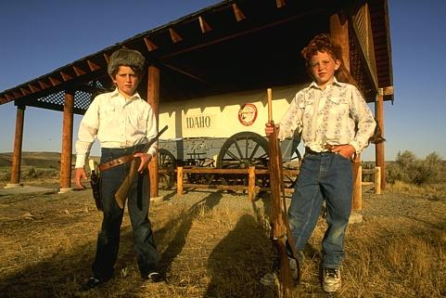
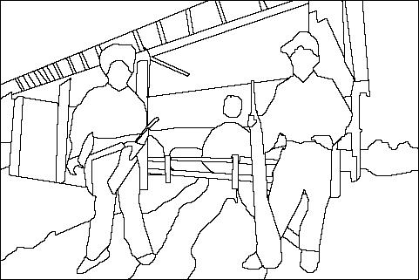
Task 2: Recognition
Separate image into coherent “objects”
“Bottom-up” or “top-down” process?
Supervised or unsupervised?
image
human segmentation
Berkeley segmentation database: http://www.eecs.berkeley.edu/Research/Projects/CS/vision/grouping/segbench/

Slide 14
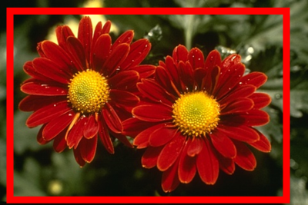
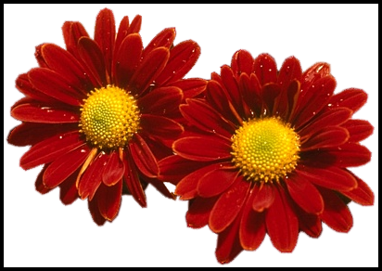
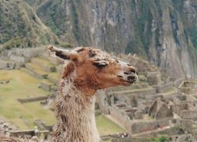
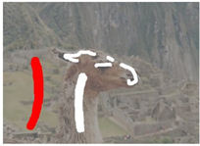
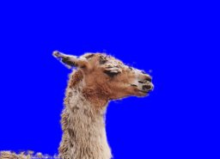
Task 3: Image manipulation
Interactive segmentation for graphics

Slide 15
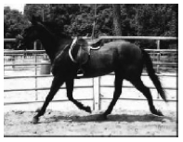
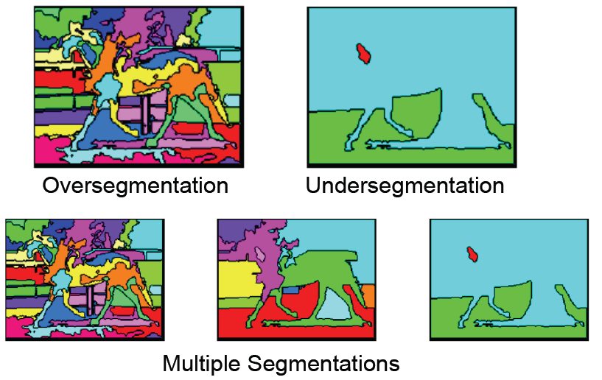
Challenges with segmentation

Slide 16
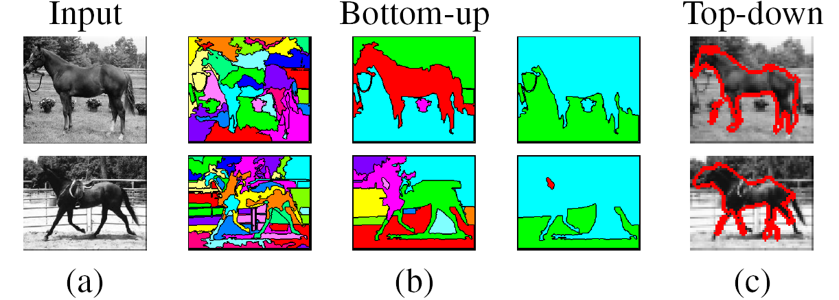
High-level approaches to segmentation
Bottom-up: group tokens with similar features
Top-down: group tokens that likely belong to the same object
[Levin and Weiss 2006]

Slide 17
Approaches to segmentation
Clustering for segmentation
Graph partitioning for segmentation
Labeling as segmentation

Slide 18
Segmentation as clustering
Clustering: grouping together similar points and represent them with a single token
Key Challenges:
What makes two points/images/patches similar?
How do we compute an overall grouping from pairwise similarities?

Slide 19
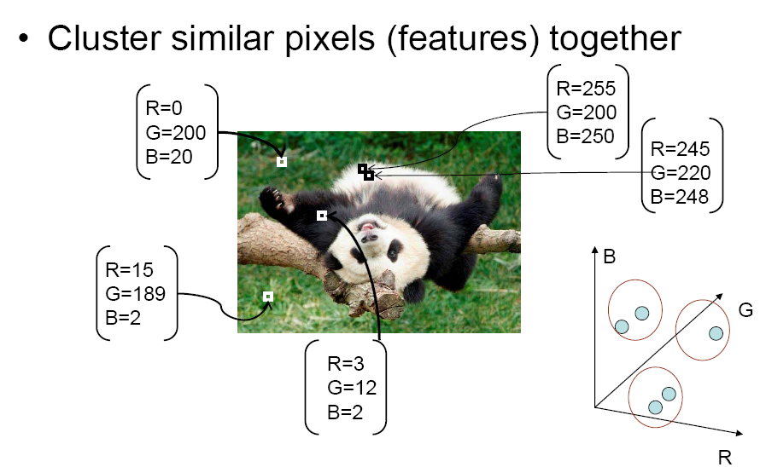
Segmentation as clustering
Source: K. Grauman

Slide 20
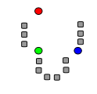
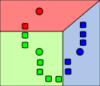
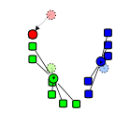
K-means algorithm
1. Randomly select K centers
2. Assign each point to nearest center
3. Compute new center (mean) for each cluster
Illustration: http://en.wikipedia.org/wiki/K-means_clustering

Slide 21
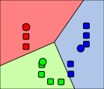
K-means algorithm
1. Randomly select K centers
2. Assign each point to nearest center
Back to 2
3. Compute new center (mean) for each cluster
Illustration: http://en.wikipedia.org/wiki/K-means_clustering

Slide 22
K-means
Initialize cluster centers: c⁰ ; t=0
Assign each point to the closest center
Update cluster centers as the mean of the points
Repeat 2-3 until no points are re-assigned (t=t+1)

Slide 23
K-means: design choices
Initialization
Randomly select K points as initial cluster center
Or greedily choose K points to minimize residual
Distance measures
Traditionally Euclidean, could be others
Optimization
Will converge to a local minimum
May want to perform multiple restarts

Slide 24
How to choose the number of clusters?
Validation set
Try different numbers of clusters and look at performance
When building dictionaries (discussed in a previous class), more clusters typically work better

Slide 25
How to evaluate clusters?
Generative
How well are points reconstructed from the clusters?
Discriminative
How well do the clusters correspond to labels?
Purity
Note: unsupervised clustering does not aim to be discriminative

Slide 26
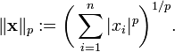
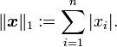
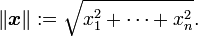
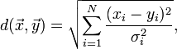
Common similarity/distance measures
P-norms
City Block (L1)
Euclidean (L2)
L-infinity
Mahalanobis
Scaled Euclidean
Cosine distance
Here x_{i} is the distance between two points

Slide 27
Conclusions: K-means
Good
Finds cluster centers that minimize conditional variance (good representation of data)
Simple to implement, widespread application
Bad
Prone to local minima
Need to choose K
All clusters have the same parameters (e.g., distance measure is non-adaptive)
Can be slow: each iteration is O(KNd) for N d-dimensional points

Slide 28
K-medoids
Just like K-means except
Represent the cluster with one of its members, rather than the mean of its members
Choose the member (data point) that minimizes cluster dissimilarity
Applicable when a mean is not meaningful
E.g., clustering values of hue or using L-infinity similarity

Slide 29
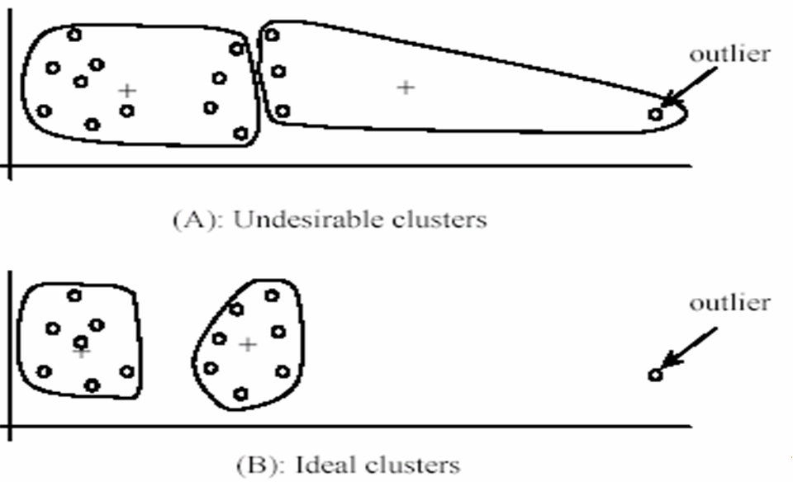
K-Means pros and cons
Pros
Simple and fast
Easy to implement
Cons
Need to choose K
Sensitive to outliers
Usage
Rarely used for pixel segmentation

Slide 30
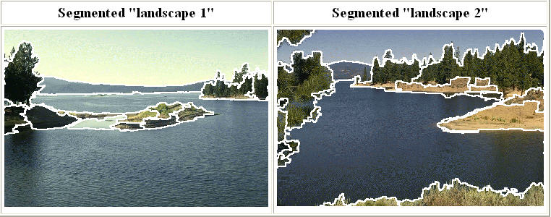
Mean shift segmentation
D. Comaniciu and P. Meer, Mean Shift: A Robust Approach toward Feature Space Analysis, PAMI 2002.
Versatile technique for clustering-based segmentation

Slide 31
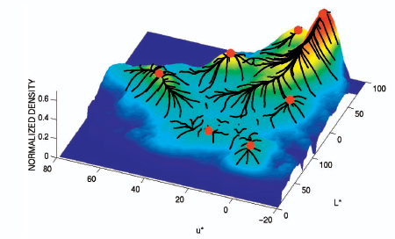
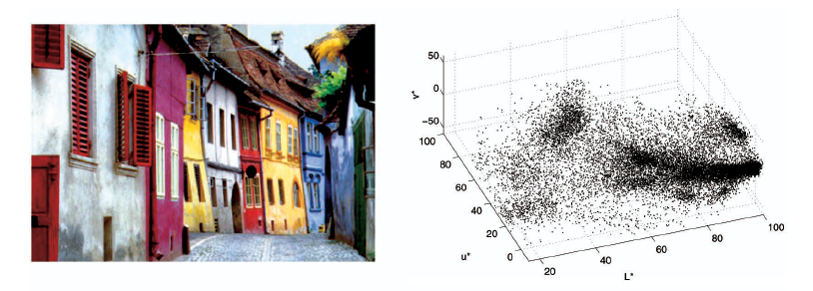
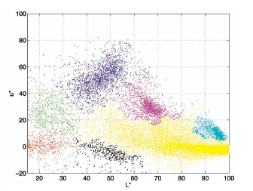
Mean shift algorithm
Try to find modes of this non-parametric density

Slide 32
Kernel density estimation (KDE)
A non-parametric way to estimate the probability density function of a random variable.
Inferences about a population are made based only on a finite data sample.
Also termed the Parzen–Rosenblatt window method,
Named fter Emanuel Parzen and Murray Rosenblatt, who are usually credited with independently creating it in its current form

Slide 33
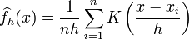
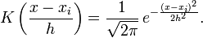
Kernel density estimation
Kernel density estimation function
Gaussian kernel

Slide 34
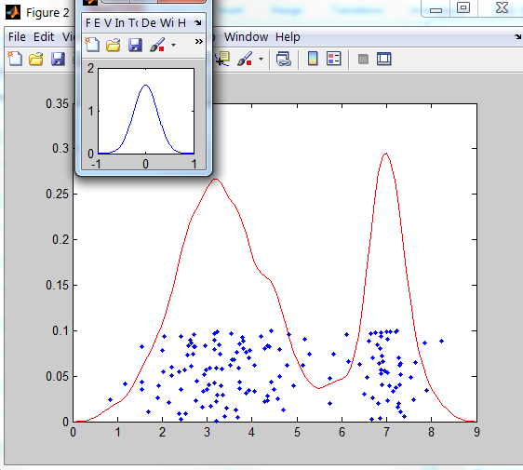
Kernel density estimation
Kernel
Estimated density
Data (1-D)

Slide 35
Mean shift
Region of
interest
Center of
mass
Mean Shift
vector
Slide by Y. Ukrainitz & B. Sarel

Slide 36
Mean shift
Region of
interest
Center of
mass
Mean Shift
vector
Slide by Y. Ukrainitz & B. Sarel

Slide 37
Mean shift
Region of
interest
Center of
mass
Mean Shift
vector
Slide by Y. Ukrainitz & B. Sarel

Slide 38
Mean shift
Region of
interest
Center of
mass
Mean Shift
vector
Slide by Y. Ukrainitz & B. Sarel

Slide 39
Mean shift
Region of
interest
Center of
mass
Mean Shift
vector
Slide by Y. Ukrainitz & B. Sarel

Slide 40
Mean shift
Region of
interest
Center of
mass
Mean Shift
vector
Slide by Y. Ukrainitz & B. Sarel

Slide 41
Mean shift
Region of
interest
Center of
mass
Slide by Y. Ukrainitz & B. Sarel

Slide 42
Computing the Mean Shift
Simple Mean Shift procedure:
Compute mean shift vector
Translate the Kernel window by m(x)
Slide by Y. Ukrainitz & B. Sarel

Slide 43
Real Modality Analysis

Slide 44
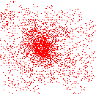
Attraction basin
Attraction basin: the region for which all trajectories lead to the same mode
Cluster: all data points in the attraction basin of a mode
Slide by Y. Ukrainitz & B. Sarel

Slide 45
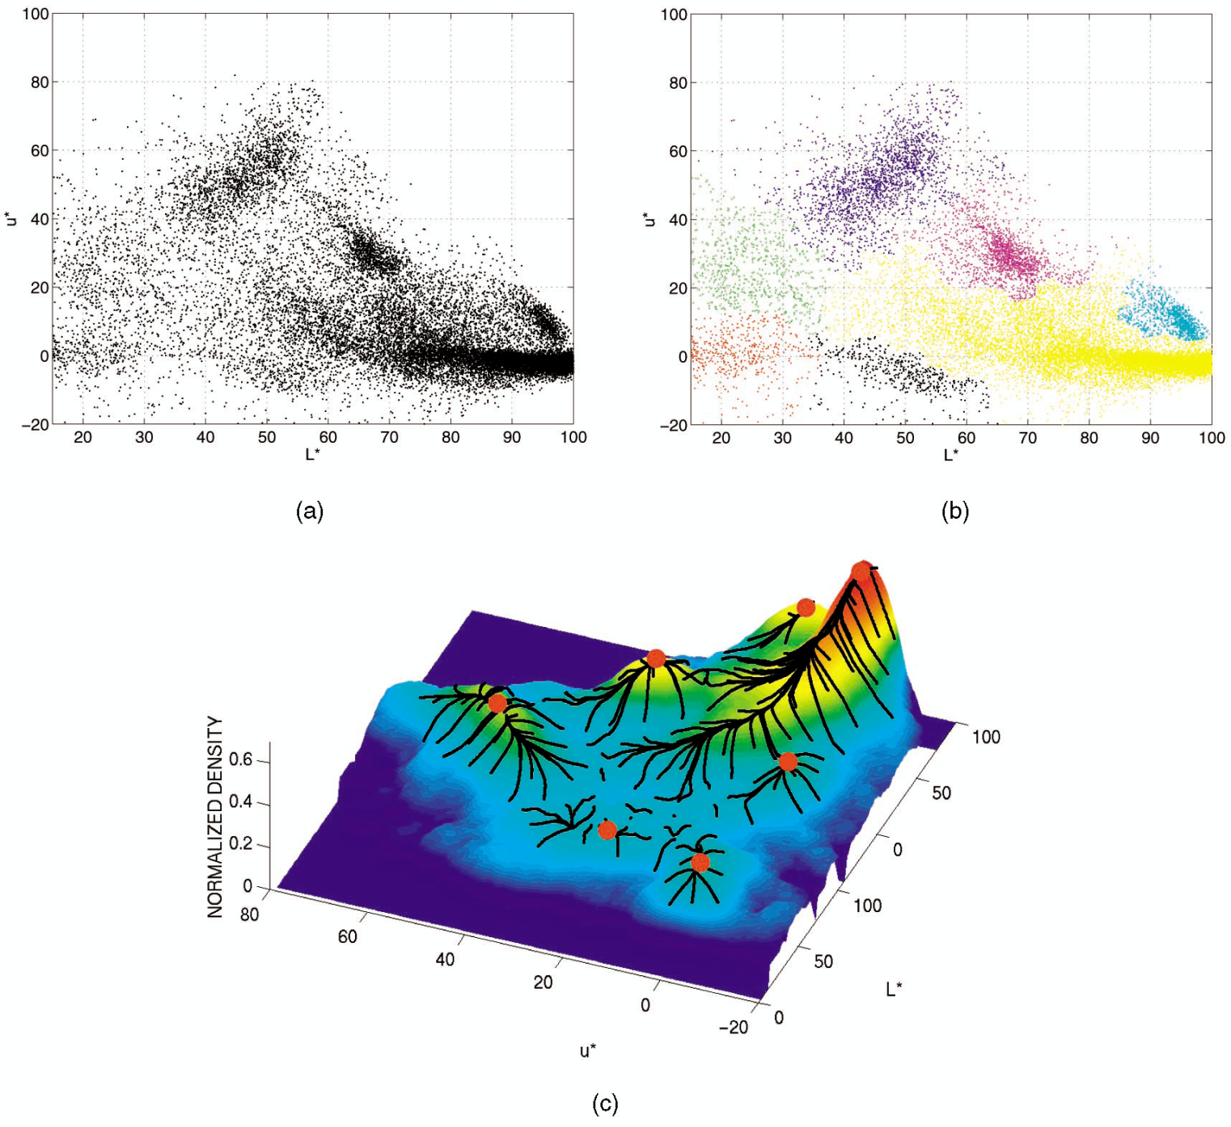
Attraction basin

Slide 46
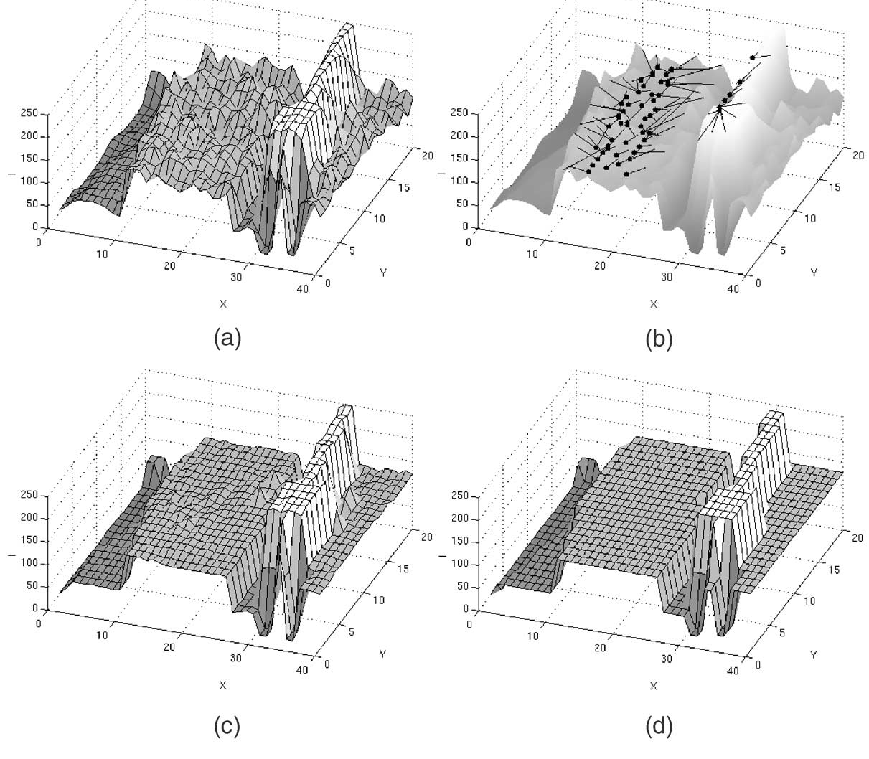
Mean shift filtering and segmentation for grayscale data; (a) input data (b) mean shift paths for the pixels on the plateaus (c) filtering result (d) segmentation result
http://www.caip.rutgers.edu/~comanici/Papers/MsRobustApproach.pdf

Slide 47
Mean shift clustering
The mean shift algorithm seeks modes of the given set of points
Choose kernel and bandwidth
For each point:
Center a window on that point
Compute the mean of the data in the search window
Center the search window at the new mean location
Repeat (b,c) until convergence
Assign points that lead to nearby modes to the same cluster

Slide 48

Segmentation by Mean Shift
Compute features for each pixel (color, gradients, texture, etc); also store each pixel’s position
Set kernel size for features K_{f} and position K_{s}
Initialize windows at individual pixel locations
Perform mean shift for each window until convergence
Merge modes that are within width of K_{f} and K_{s}

Slide 49
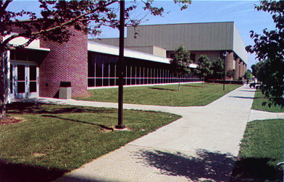
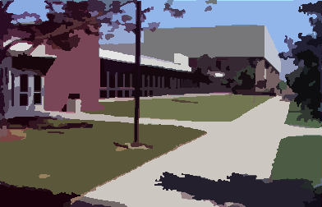


Mean shift segmentation results
http://www.caip.rutgers.edu/~comanici/MSPAMI/msPamiResults.html

Slide 50

http://www.caip.rutgers.edu/~comanici/MSPAMI/msPamiResults.html

Slide 51
Mean shift pros and cons
Pros
Good general-purpose segmentation
Flexible in number and shape of regions
Robust to outliers
Cons
Have to choose kernel size in advance
Not suitable for high-dimensional features
When to use it
Oversegmentation
Multiple segmentations
Tracking, clustering, filtering applications
D. Comaniciu, V. Ramesh, P. Meer: Real-Time Tracking of Non-Rigid Objects using Mean Shift, Best Paper Award, IEEE Conf. Computer Vision and Pattern Recognition (CVPR'00), Hilton Head Island, South Carolina, Vol. 2, 142-149, 2000

Slide 52
Further reading on mean shift
Nicely written mean-shift explanation (with math)
http://saravananthirumuruganathan.wordpress.com/2010/04/01/introduction-to-mean-shift-algorithm/
Includes .m code for mean-shift clustering --- feel free to look at it but your code for segmentation will be different
Mean-shift paper by Comaniciu and Meer
http://www.caip.rutgers.edu/~comanici/Papers/MsRobustApproach.pdf
Adaptive mean shift in higher dimensions
http://mis.hevra.haifa.ac.il/~ishimshoni/papers/chap9.pdf

Slide 53

Segmentation as graph partitioning
The set of points in an arbitrary feature space can be represented as a weighted undirected complete graph
G = (V, E), where the nodes of the graph are the points in the feature space.
The weight w_{ij} of an edge (i, j) $∈$ E is a function of the similarity between the nodes and i and j.
We can formulate image segmentation problem as a graph partitioning problem that asks for a partition of V₁,…….V_{k}, of the vertex set V; such that the vertices in Vi have high similarity and those in V_{i}, V_{j} have low similarity.

Slide 54

Segmentation as graph partitioning
j
w_{ij}
i
Node for every pixel
Edge between every pair of pixels (or every pair of “sufficiently close” pixels)
Each edge is weighted by the affinity or similarity of the two nodes
Source: S. Seitz

Slide 55

Measuring affinity

Slide 56

Measuring affinity
Represent each pixel by a feature vector x and define an appropriate distance function
Role of σ

Slide 57
Segmentation as graph partitioning
j
w_{ij}
i
A
B
C
Break Graph into Segments
Delete links that cross between segments
Easiest to break links that have low affinity
similar pixels should be in the same segments
dissimilar pixels should be in different segments
Source: S. Seitz

Slide 58
General: Graph cut
B
A
Set of edges whose removal makes a graph disconnected
Cost of a cut: sum of weights of cut edges
A graph cut gives us a segmentation
What is a “good” graph cut and how do we find one?
Source: S. Seitz

Slide 59


Minimum cut
We can do segmentation by finding the minimum cut in a graph
Efficient algorithms exist for doing this

Slide 60
Normalized cut
Drawback: minimum cut tends to cut off very small, isolated components
Cuts with
lesser weight
than the
ideal cut
Ideal Cut
* Slide from Khurram Hassan-Shafique CAP5415 Computer Vision 2003

Slide 61
Normalized cut
Drawback: minimum cut tends to cut off very small, isolated components
This can be fixed by normalizing the cut by the weight of all the edges incident to the segment
The normalized cut cost is:
Finding the globally optimal cut is NP-complete, but a relaxed version can be solved using a generalized eigenvalue problem
w(A, B) = sum of weights of all edges between A and B
J. Shi and J. Malik. Normalized cuts and image segmentation. PAMI 2000

Slide 62



Slide 63
Normalized cuts: Pro and con
Pro
Generic framework, can be used with many different features and affinity formulations
Con
High storage requirement and time complexity: involves solving a generalized eigenvalue problem of size n x n, where n is the number of pixels

Slide 64

Segmentation as labeling
Suppose we want to segment an image into foreground and background
Binary labeling problem
Credit: N. Snavely

Slide 65
Segmentation as labeling
Suppose we want to segment an image into foreground and background
Binary labeling problem
User sketches out a few strokes on foreground and background…
How do we label the rest of the pixels?
Source: N. Snavely

Slide 66


Binary segmentation as energy minimization
Define a labeling L as an assignment of each pixel with a 0-1 label (background or foreground)
Find the labeling L that minimizes
data term
smoothness term
How similar is each labeled pixel to the foreground or background?
Encourage spatially coherent segments
Source: N. Snavely

Slide 67





{
computed by creating a color model from user-labeled pixels
: “distance” from pixel to background
: “distance” from pixel to foreground
Source: N. Snavely

Slide 68



Source: N. Snavely

Slide 69



Neighboring pixels should generally have the same labels
Unless the pixels have very different intensities
: similarity in intensity of p and q
= 10.0
= 0.1
Source: N. Snavely

Slide 70
Binary segmentation as energy minimization
For this problem, we can efficiently find the global minimum using the max flow / min cut algorithm
Y. Boykov and M.-P. Jolly, Interactive Graph Cuts for Optimal Boundary and Region Segmentation of Objects in N-D Images, ICCV 2001
Source: N. Snavely

Slide 71




Efficient graph-based segmentation
P. Felzenszwalb and D. Huttenlocher, Efficient Graph-Based Image Segmentation, IJCV 2004

Slide 72
Superpixels
Group together similar-looking pixels for efficiency of further processing
“Bottom-up” process
Unsupervised
“superpixels”
X. Ren and J. Malik. Learning a classification model for segmentation. ICCV 2003.

Slide 73
Felzenszwalb and Huttenlocher: Graph-Based Segmentation
http://www.cs.brown.edu/~pff/segment/
+ Good for thin regions
+ Fast, runs in time nearly linear in the number of edges
+ Easy to control coarseness of segmentations
+ Can include both large and small regions
- Often creates regions with strange shapes
- Sometimes makes very large errors

Slide 74

Turbo Pixels: Levinstein et al. 2009
http://www.cs.toronto.edu/~kyros/pubs/09.pami.turbopixels.pdf
Tries to preserve boundaries and produces more regular regions

Slide 75
Applications of segmentation
Shot boundary detection
summarize videos by
finding shot boundaries
obtaining “most representative” frame
Background subtraction
find “interesting bits” of image by subtracting known background
e.g. sports videos
e.g. find person in an office
e.g. find cars on a road
Interactive segmentation
user marks some foreground/background pixels
system cuts object out of image
useful for image editing, etc.

Slide 76
Final thoughts
Segmentation is a difficult topic with a huge variety of implementations.
It is typically hard to assess the performance of a segmenter at a level more useful than that of showing some examples
There really is not much theory available to predict what should be clustered and how.
Everyone should know about some clustering techniques like k-means, mean shift, and at least one graph-based clustering algorithm
these ideas are just so useful for so many applications
segmentation is just one application of clustering.

Slide 77
Slide Credits
Svetlana Lazebnik – UIUC
Derek Hoiem – UIUC
David Forsyth - UIUC

Slide 78

Questions

